Slide 1
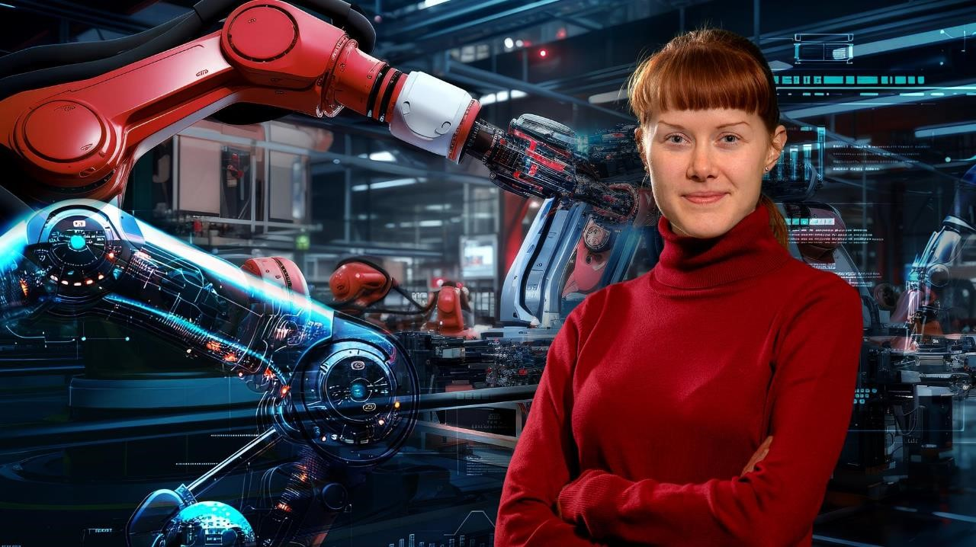
THINK GlobalLY,
ACT GLOBALLY

Slide 2

OUR RESPONSIBILITY
„
The strength of our university arises from its clear profile and the commitment of its members across disciplinary boundaries. Diversity, tolerance, and a lived openness to the world shape our university community.
For over 250 years, we have been teaching and researching topics that lay the foundations for society and its essential services. Never before in history have the challenges been so fundamental and existential for future development. The guiding principle of actively initiating and participating in transformation processes for the sustainable development of society is at the core of our university. Engaging with economic, ecological, and technical issues that affect humanity's future shapes our research and teaching.
„
Notes:
Das Selbstverständnis der TU Bergakademie Freiberg

Slide 3
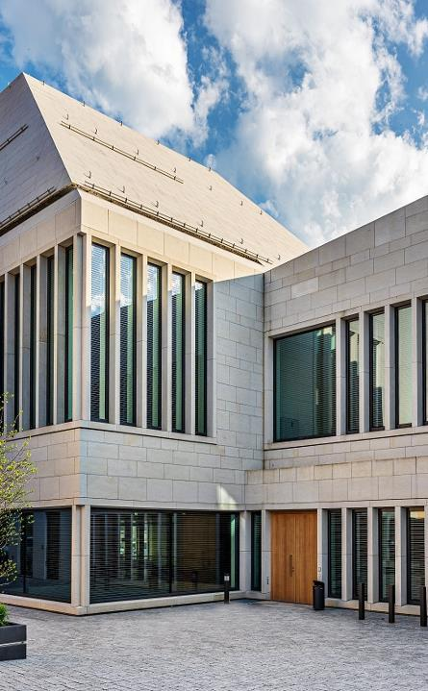
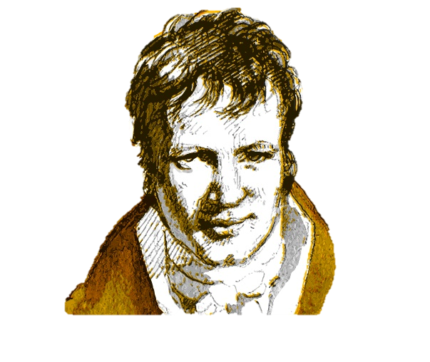
UNIVERSITY PROFILE
One of Germany's most research-intensive universities
Clear and unique research profile as a resource university
Strong interdisciplinarity in research and teaching
Globally recognized resource university
Freiberg.Science.City. – a renowned science location
A university town with tradition – Alexander von Humboldt studied here, and the discovery of the elements Germanium and Indium marked scientific milestones
Notes:
Weitere historische Persönlichkeiten:
Abraham-Gottlob Werner – Begründer der modernen Geologie
Lampadius – Gasbeleuchtung auf dem europäischen Kontinent

Slide 4
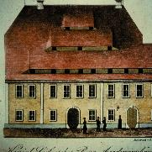
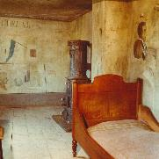
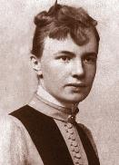

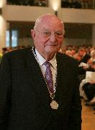

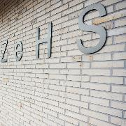
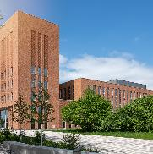
FROM OUR HISTORY
Founding
of the Bergakademie
21. Nov 1765
Student Detention Room
The only preserved student detention room (Karzer) at a German University of Technology
Independent right to confer doctorates
Establishment of the Dr. Erich Krüger Foundation
Foundation of HIF
New Library and Lecture Hall Center
1765
1796
1851-1872
1885
1920
1993
2006
2008
2011
2021
2023
First university laboratory established by Prof. Lampadius
First female student, Mary Hegeler, enrolled
Right to the designation "Technical University"
Opening of
terra mineralia
Opening of ZEHS

Slide 5
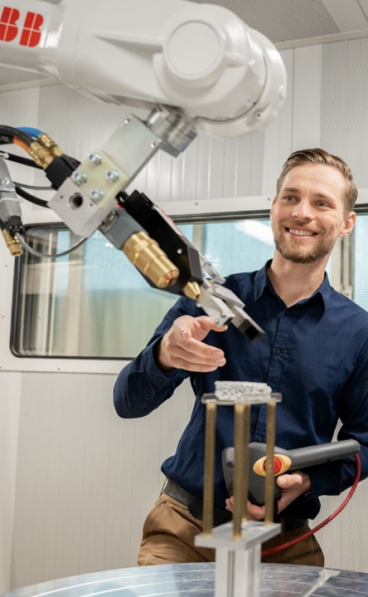
HOLISTIC TEACHING & RESEARCH
Interdisciplinary network – our six faculties
Faculty 1 Mathematics and Computer Science
Faculty 2 Chemistry, Physics and Bioscience
Faculty 3 Geosciences, Geoengineering and Mining
Faculty 4 Mechanical, Process and Energy Engineering
Faculty 5 Materials Science and Technology
Faculty 6 Business Administration
32 Institutes
6 Faculties
89 Professors
6 Junior professors
As of: 01.05.2024

Slide 6

EUROPEAN UNIVERSITY
EURECA-PRO - TU Bergakademie is part of the European
University Alliance for Sustainability of the EU
Studying and researching together for greater sustainability
Research, teaching, and strategic development
Transfer and communication as bridges to society
Partnerships
Montanuniversität Leoben
Technical University of Crete
Universidad de León
Silesian University of Technology
Universitatea din Petroșani
Hochschule Mittweida
Hasselt University
Université de Lorraine

Slide 7
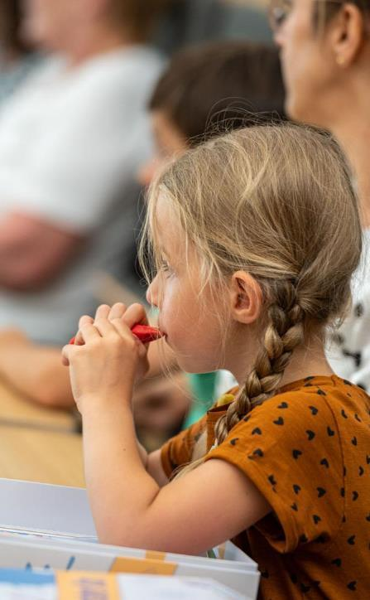

FAMILY-FRIENDLY UNIVERSITY
Support services for studying with children
A variety of counseling services
Arrangement of an individual study plan
Childcare
Accommodation options for student parents
Baby care rooms and play areas on campus
Junior University and Junior Researchers
Family-friendly working conditions
Service agreement for mobile work
Support for balancing work, caregiving, and family
Notes:
2023 hat die das Zertifikat als familiengerechte Hochschule erhalten

Slide 8

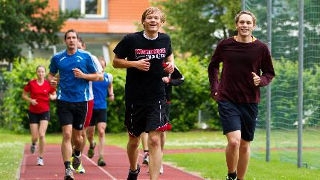
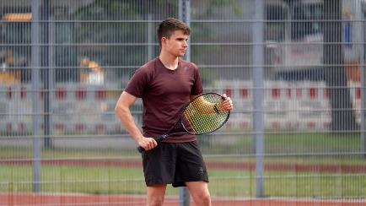
ACTIVE TOGETHER
Preservation and promotion of the health of employees and students
Health-related offers and initiatives
Creation and maintenance of healthy working, teaching, and research conditions
University Health Management
Programs to promote physical, mental, and social health
University Sports Center
More than 40 sports and 80 courses

Slide 9
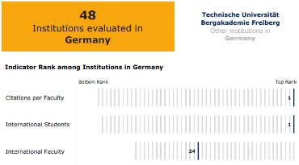

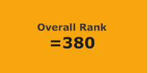
QS WORLD UNIVERSITY RANKINGS 2025
Overall International Result
Comparison within Germany
380
1401+
2024
2025
Ranking by Subject - Germany
Ranked 1st among German universities in Geoengineering (Mining and Minerals Engineering)
Ranked 2nd among German universities in Drilling Technology and Fluid Mining (Placeholder)

Slide 10
STUDY AND
TEACHING

Slide 11
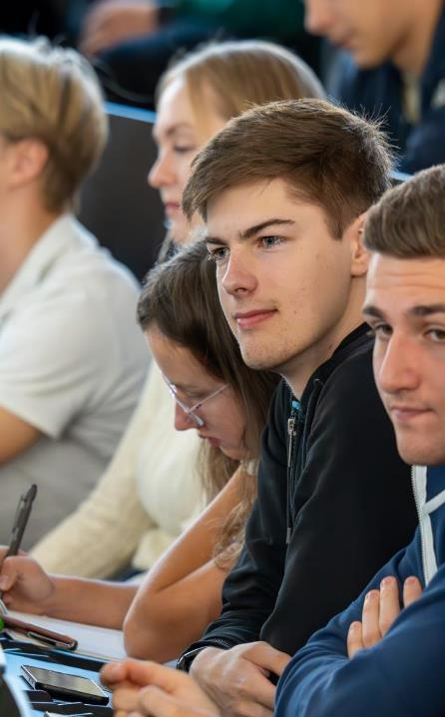
MISSION STATEMENT FOR TEACHING &
STUDYING
Teaching – diverse, interdisciplinary, practice-oriented
Conveying subject-specific and interdisciplinary competencies
Integration of current research findings
Promotion of research-based thinking
Practical relevance
Promotion of intercultural exchange and global cooperation
Diversity-conscious teaching
Integration of digital technologies to enhance teaching methods
Preparation for the digital workplace
Further education and training for lifelong learning
Notes:
Kompetenz
Hohe fachliche & interdisziplinäre Kompetenzen für die verantwortungsvolle Gestaltung der Zukunft
Forschungsorientierte Lehre
Praxisnähe des Studiums
Verbindung von theoretischem Wissen mit Fach- und Laborpraktika, Exkursionen, Zusammenarbeit mit Unternehmen und Forschungseinrichtungen weltweit
Internationalität
Interkultureller Austausch & Zusammenarbeit weltweit, sowie vielfältige internationale Studiengänge
Diversitätsgerechte Lehre
Diversitätssensibles Lernen und Lehren durch flexible Studienpläne und Betreuungsangebote Digitalisierung
Präsenzlehre mit Unterstützung und Ergänzung durch digitale Technologien und Methoden
Lebenslanges Lernen
Fortbildungen und Weiterbildungen für lebenslanges Lernen

Slide 12
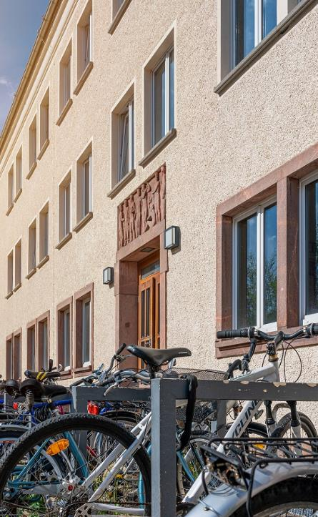
#TUBAFstudium
Friendly atmosphere
Excellent advisory and support network
Individual study organization
Campus University
  Short distances to lecture halls
  Modern facilities
  Laboratories, technical equipment, and large research facilities on campus
  Lecture halls and laboratory spaces are guaranteed
Central campus housing
  10 residential complexes – all-inclusive apartments and rooms (furniture, water, electricity, heating, internet, TV (cable connection))
  Rent between €220 and €415 per month
Notes:
In Freiberg können Studierende campusnah und umgeben von der historischen Altstadt studieren, wohnen und leben – und das bezahlbar!
Jeder Student:in bekommt in Freiberg eine Wohnung
Freiberg bietet lt. einem Wohnungscouring den günstigsten Wohnraum für Studierende.

Slide 13
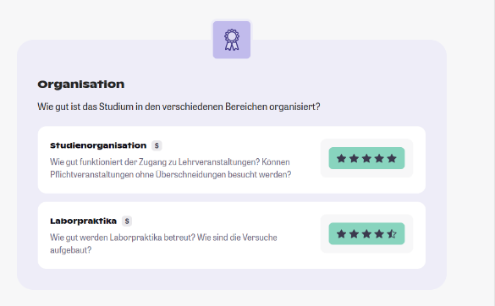
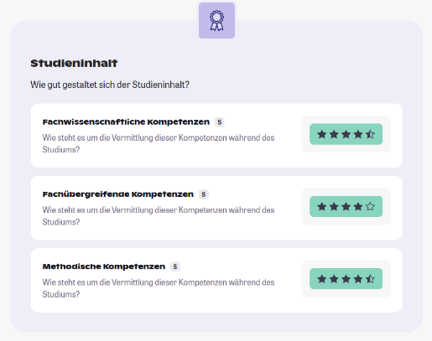
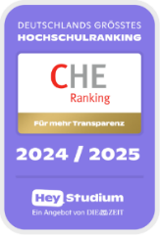
CHE-RANKING 2024: CHEMISTRY

Slide 14
INNOVATIVE STUDY CONCEPTS
68 Bachelor‘s, Master‘s and Diploma degree programs, including:
  Geosciences and Geoengineering 15
  Engineering Sciences 18
  Materials and Materials Science 7
  Business Sciences 13
  Mathematics, Computer Science, and Natural Sciences 9
33% female students
3.712 Students
83% STEM students
52% international students
As of: 01.05.2024
Notes:
Und weitere Studiengänge mit Mehrfachabschlüssen: ENTER, EMERALD, SINREM

Slide 15

STUDENTS BY FIELD OF STUDY WiSe 2023/24

Slide 16

FORMS OF STUDY
On-campus study with virtual offerings
Cooperative Studies
Study programs with strong industry partners
Teacher training-oriented programs in STEM fields
Applied Computer Science, Applied Natural Sciences
Orientation study program WIN
(2 semesters of courses in business, law, engineering, and natural
sciences, tailored to individual needs)
Mobility study with multiple joint Master's degrees
EMERALD, ENTER, SINREM, RAVEN programs – Triple degree
programs, typically starting at a partner university abroad

Slide 17
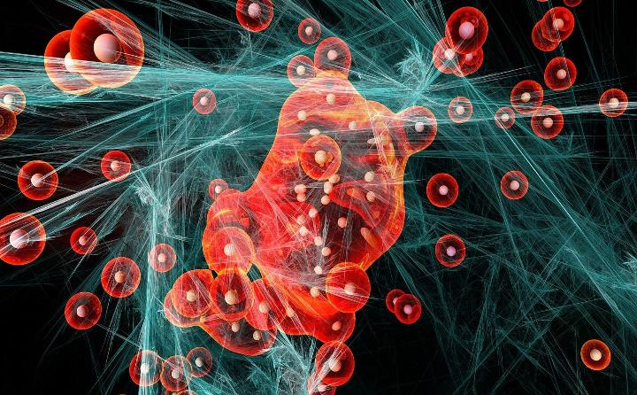

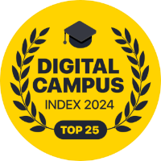
OFFERINGS IN THE VIRTUAL SPACE
Virtual teaching and learning offerings complement on-site
instruction, such as:
Virtual student mobility and teaching support for Ukraine
E-assessment and digital exams
Mixed- und Metareality teaching collections
  Cornerstone – Virtual Reality in Geoscience
Digital internships and virtual laboratories
Notes:
Über die Umfrage „Digital Campus“
In der Umfrage der Uni Now GmbH haben rund 12.700 Studierende von 239 Hochschulen aus ganz Deutschland ihre Stimme abgegeben und bewertet, wie digital ihre Hochschule in den Bereichen Lehre, Ausstattung und Verwaltung ist. Der Digital Campus Award wurde 2024 zum ersten Mal von UniNow vergeben und soll in den Folgejahren zunehmend zur Einschätzung des eigenen Fortschritts der deutschen Universitäten auf dem Weg zu digitaler Lehre, Forschung und Verwaltung dienen.

Slide 18
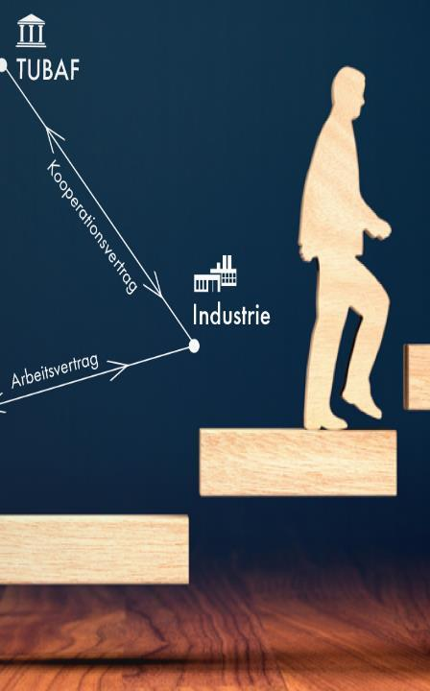
COOPERATIVE STUDIES
ADVANTAGE
Networking with industry partners
Getting to know the professional world early
Financial support for studies
Internship
Supervision of a thesis
Part-time employment
TYPES
BASIS
Part-time contract with individual agreements on salary, working hours, and objectives

Slide 19

STUDY FINANCING
Study funding through BAföG
29th BAföG amendment in 2024 with increased financial allowances, introduction of a study start-up aid, and higher housing cost allowances for students living away from home
Deutschlandstipendium
118 Deutschlandstipendium recipients in 2023
Job opportunities
For student and research assistants at our institutes
Student internship agreements with industry
Especially in engineering sciences
Cooperative Study
Studying in collaboration with universities and industry partners

Slide 20
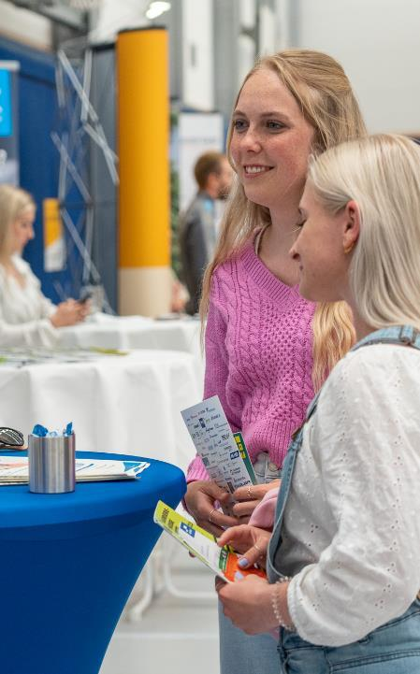
CAREER SERVICES
Career entry preparation counseling
Development of personal and competency profiles
Individual application portfolio review
Preparation for job interviews
Training in professional and leadership skills
Development of soft skills
Building interdisciplinary knowledge
Coaching for job applications and career start
Networking
Career fair ORTE connects students with companies
Job offers
Own dedicated job portal "Jobteaser"

Slide 21
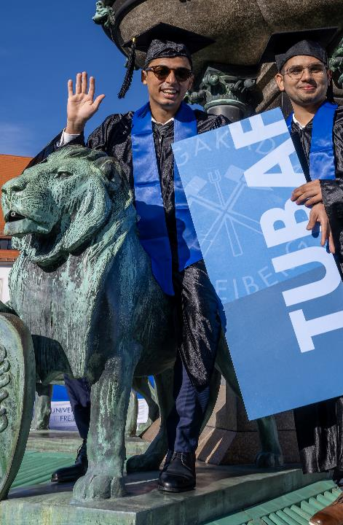
PROGRAMS FOR
EARLY-CAREER ACADEMICS
Doctorates
Conventional Doctorate or
Doctorate within the framework of a structured doctoral program
Graduate Program
Graduate schools and
Early-Career Research Groups
Continuing Education Program and Workshops
Consulting and Coaching
Notes:
Graduierten- und Forschungsakademie GraFa unterstützt und begleitet die wissenschaftliche Nachwuchsförderung

Slide 22
International
ORIENTATION
AND NETWORKING

Slide 23
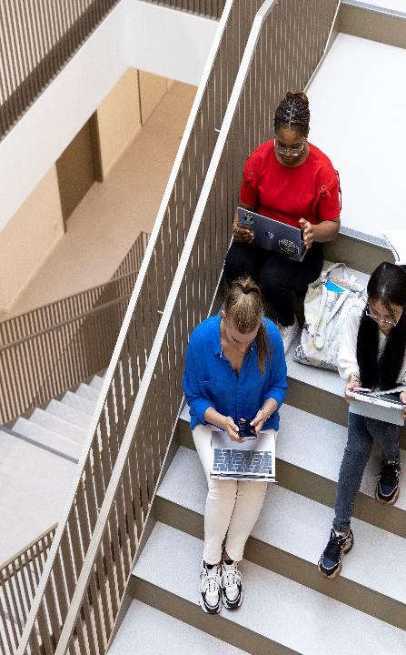
STUDENTS FROM AROUND THE WORLD
Stand: 01.11.2024

Slide 24

INTERNATIONAL MOBILITY
255 partner universities
across six continents in 70 countries
Erasmus+ Study and Internship worldwide
Erasmus+ Multiple Degree Programs
ENTER – M. Sc. in Engineering, Entrepreneurship and Resources
EMerald – M. Sc. in Georesources Engineering
SINReM – M. Sc. in Sustainable and Innovative Natural Resource Management
International Office
Service center for incoming and outgoing
Welcome Center for international students

Slide 25

SAXON LIAISON OFFICES WORLDWIDE
SAXON SCIENCE LIAISON
Attracting students to study
at a Saxon university
Offices of the Saxon universities:
TU Dresden: :
Taiwan, India, Chennai
TU Chemnitz:
Chile, Santiago
Universität Leipzig:
Vietnam, Hanoi
TUBAF:
Uzbekistan: Taschkent
Mongolia: Ulaanbaatar
TUBAF / Univ. Lpz. / HAW:
Africa, Egypt, …

Slide 26
SCIENCE
AND
RESEARCH

Slide 27
AREAS OF EXPERTISE
Energy and
Energy systems
Climate and Environment
Engineering / Technologies
Robotics and AI (Artificial Intelligence)
Raw Materials, Materials, and Composites
Economics and Law

Slide 28



RESEARCH AND SCIENCE CAMPUS
Profile
Geo - Materials / Composites - Energy - Environment
Innovative University
Cooperation network with BA Sachsen, University of Meißen, and the State Association of Cultural & Creative Industries
Research Strength
Top 10 in third-party funding per professor nationwide in Germany
Freiberg.Science.City
Network with Freiberg companies, the city, research institutions: Helmholtz Institute
Freiberg for Resource Technology (HIF), Fraunhofer THM, and the district
Scientific Infrastructure
Behavioral Research Lab, HPC Cluster, Cleanroom Laboratory, Research and Teaching Mine
Interdisciplinary Centers
Center for Water Research Freiberg (ZeWaF), Center for Efficient High-Temperature Material Transformation (ZeHS), FCCE Freiberg Center for Circular Economy, High-Pressure Research Center, Scientific Diving Center, CircEcon – Research Center for Greenhouse Gas-Neutral Circular Economy
Unique Foundation Engagement
Dr. Erich Krüger Foundation, TUBAF Foundation, and others

Slide 29

DEVELOPMENT OF THIRD-PARTY FUNDING

Slide 30
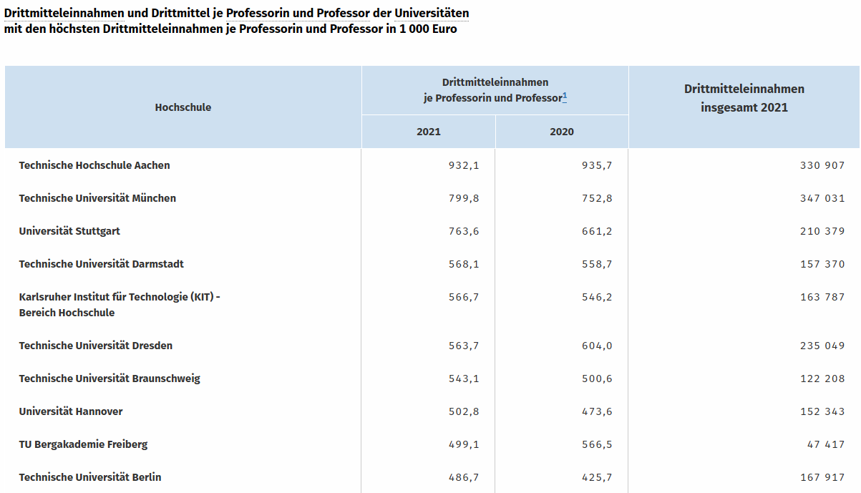

TOP 10 THIRD-PARTY FUNDING
Stand: 12.10.2023

Slide 31




SOCIAL RESPONSIBILITY AND TRANSFER
Responsibility for Solving Future Challenges
Active contributions to addressing current challenges:
Shaping the energy transition
Sustainable resource management
Climate and environmental protection
Materials and composites
Recycling
Digitalization and AI
Knowledge Transfer
Communication between Science and the Public
Technology Transfer and Commercialization Partnerships
Transfer of knowledge, inventions, and patents into industry
Entrepreneurship
Promotion of spin-offs from academia and support for innovative startups

Slide 32
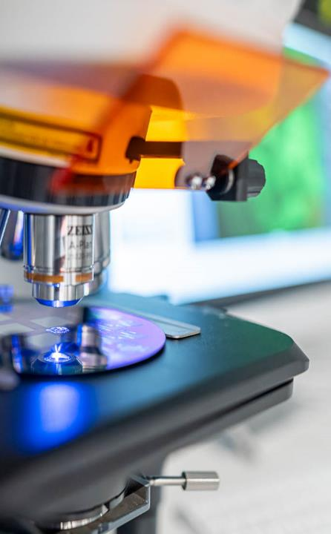
INTERDISCIPLINARY CENTERS
Center for Efficient High-Temperature Material Transformation (ZeHS)
Cooperation Center for Smart Materials Design (together with DESY)
Center for Water Research (ZeWaF)
Freiberg Center for Circular Economy (FCCE)
Freiberg High-Pressure Research Center (FHP)
Center for Intelligent Subsurface Structures
Research Center for Greenhouse Gas-Neutral Circular Economy (CircEcon)
Interdisciplinary Ecological Center (IÖZ)
Scientific Diving Center

Slide 33

DFG GRADUATE SCHOOL GRK 2802
Refractory Recycling – A Contribution to Resource, Energy, and Climate Efficiency in High-Temperature Processes
Objectives
Interdisciplinary, structured training of doctoral candidates in the field of recycling and upcycling of refractory materials
Researching a new generation of coarse-grained high-temperature materials based on refractory recyclates with special functional properties for high-temperature metallurgical processes
Core Ideas
Core Idea I: Recycling | Core Idea II: Upcycling
Refractory Recyclates for Novel Refractory Materials Using Environmentally Friendly Binders (Resin-Free, Tar-Free) | Refractory Recyclates for Novel Composite Materials
Application: Lining material for steel ladles | Application: Electrode material for aluminum melting flux electrolysis

Slide 34
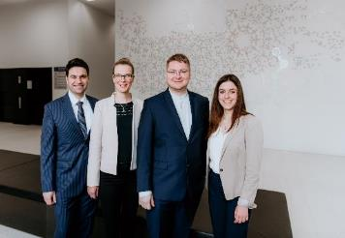

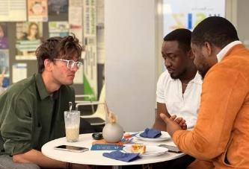
PROMOTION OF SPIN-OFFS
Saxeed Founder Network
2023 | Consulting for 35 start-up projects, resulting in 3 successful spin-offs so far
 | Support for two EXIST Research Transfers and one EXIST Start-up Scholarship, with three EXIST applications submitted
KlimaPay: Application for EXIST Start-up Scholarship
Platform for decentralized parcel delivery via private travelers, aimed at reducing the CO2 footprint (10/2023)
MiViA GmbH: Completion of an investment with the Technology Founder Fund Saxony (09/2023)
Automated microstructure analysis in seconds using artificial intelligence

Slide 35
ExCellent
InfrastructurE

Slide 36
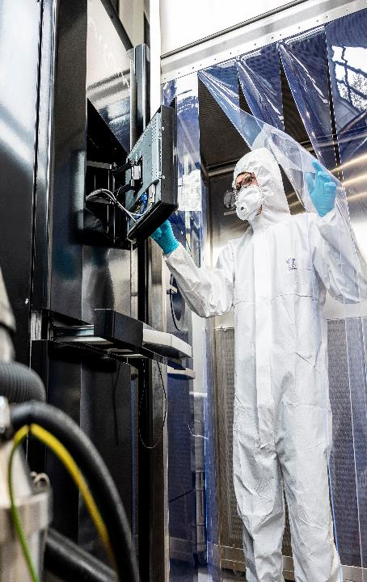
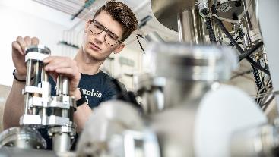
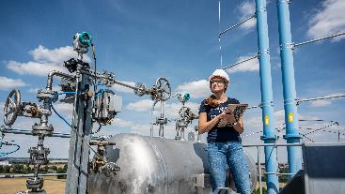
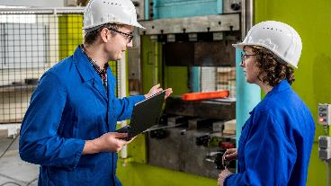
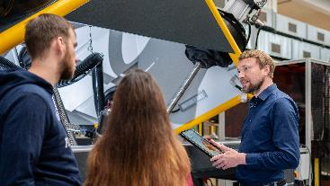
LARGE-SCALE RESEARCH,
LABORATORIES, TECHNOLOGY
Research Facilities and Institutes on Campus
Notes:
Technikum Silikattechnik, Agricolastr.
Großforschungsanlage am IEC, Reiche Zeche im Pilotmaßstab
TMV Hallo, Versuchsstand
Umformtechnikum an der Fakultät 5
Reinstraum im Gellert-Bau

Slide 37
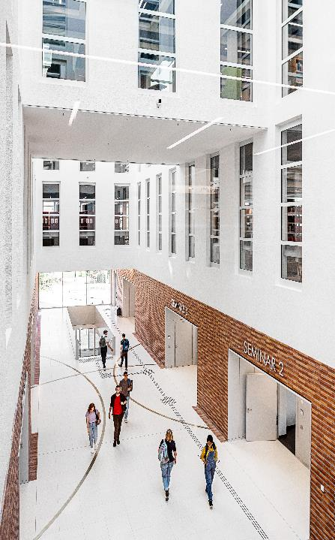
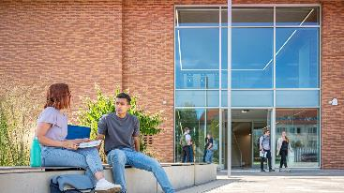
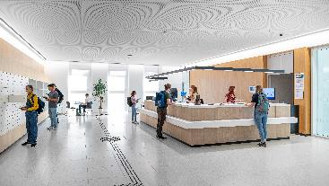
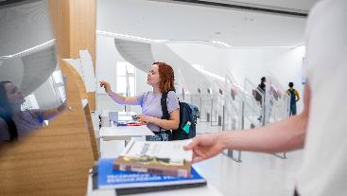
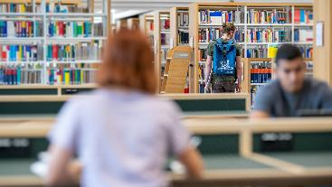
New University Library and
Lecture Hall Center
Modern Service Center for Studies and Research
Notes:
Neubau Universitäts- und Hörsaalzentrum
Übergeben zum Wintersemester 2023/24
- Im EG 2 große barrierefreie Hörsäle, 3 Seminarräume, 1 Vortragssaal
Im 1. OG: Eingangsbereich/Foyer der Bibliothek
- Bibliothek in drei Bereich unterteilt von laut nach leise, im Obergeschoss ist der hinsichtlich der Umgebungsgeräusche die größtmögliche Ruhe

Slide 38
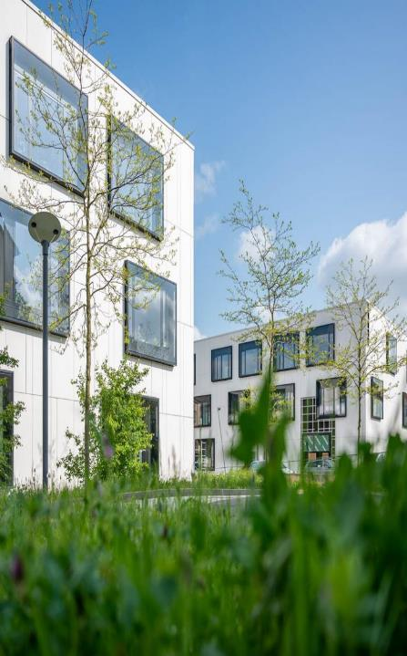
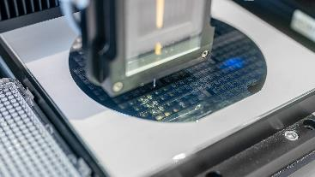
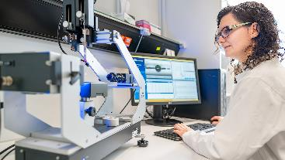
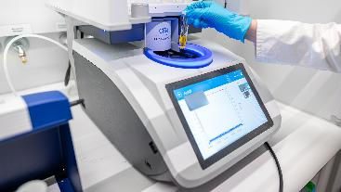
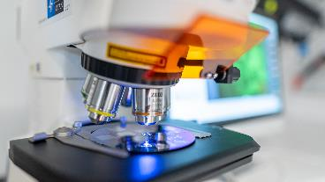
MOST MODERN LABORATORY
BUILDINGS
Clemens-Winkler laboratory
New Building with three laboratory wings
Notes:
Clemens-Winkler-Laborneubau – drei modernste Laborflügel

Slide 39
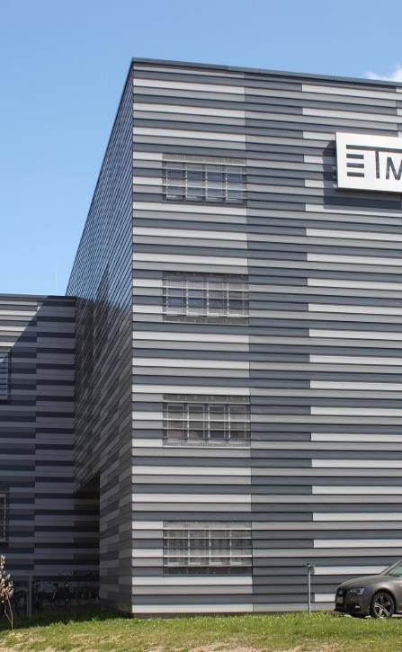
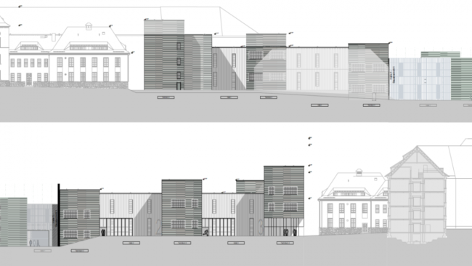
Pilot Plant for Machine and
Process Development
Expansion with two experimental halls and three pilot plant
sections
Notes:
Clemens-Winkler-Laborneubau – drei modernste Laborflügel

Slide 40




THANK YOU
FOR YOUR ATTENTION
#tubaf
TU BERGAKADEMIE FREIBERG
Akademiestraße 6
09599 Freiberg
+49 3731 39-2550, -2551
rektor@zuv.tu-freiberg.de

